Slide 1
Computer Reservation System
Alex Bisbach, Levon Swenson, Junsu Jeong, Benjamin Mehn, Evan Gjerde

Slide 2
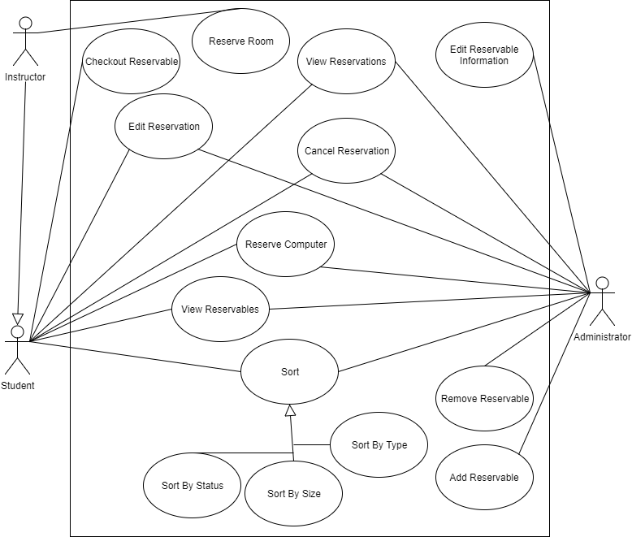

Slide 3
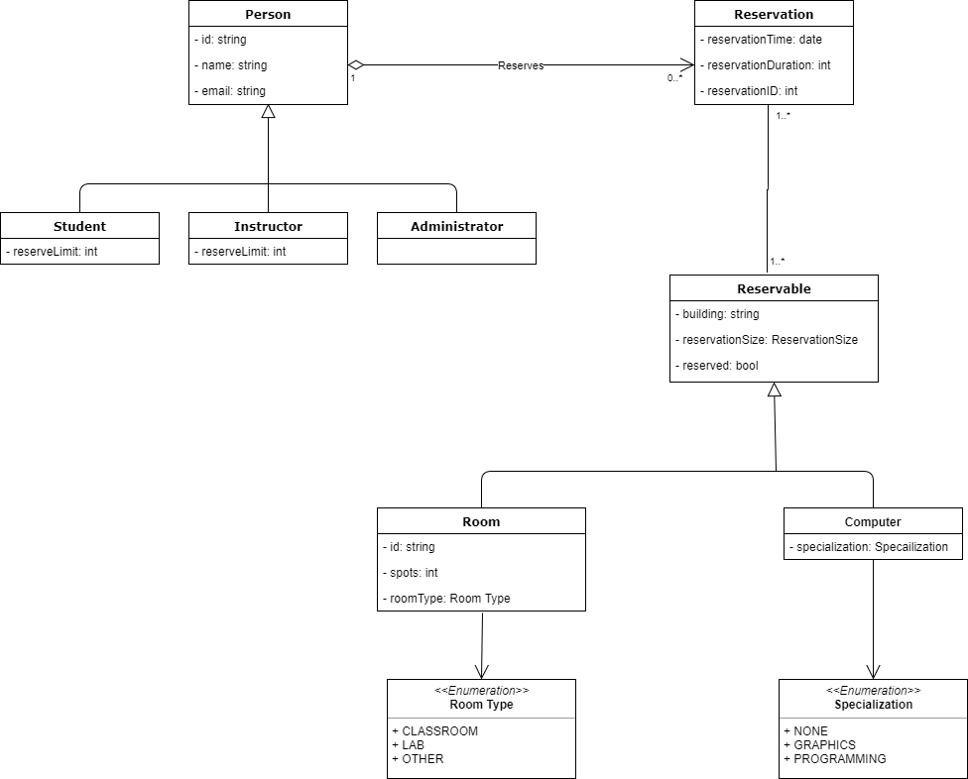

Slide 5
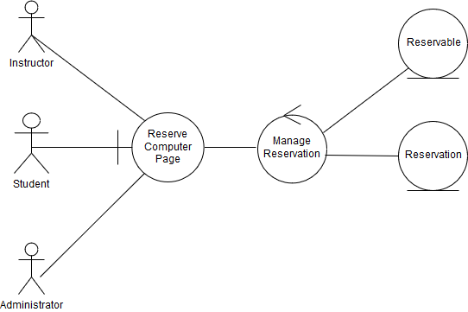
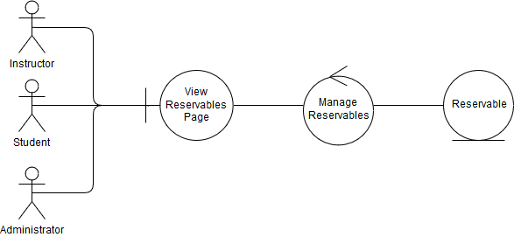
Robustness Diagrams

